Slide 1

Professional Development Skills Part 1 Week 2 – Station 1: The Starting point improving Mindset and handling stress
Lecturer: …
Email: …
Module Leader: Kenneth Cohen
Email: kenneth.cohen@london.aru.ac.uk

Slide 2

WEEK 2 - In Today’s class
PART 1: Improving Mindset (LO2)
PART 2: Managing Stress (LO2)

Slide 3



Improving mindset

Slide 4
Identifying growth mindset 1
Go to the VLE and download the PD1 Week 2 – Worksheet.
Look at TASK 1 in the document.
Divide the sentences into 2 groups.
Give each group a title.

Slide 5
Identifying growth mindset 2
Watch the video: https://www.youtube.com/watch?v=3vz6HU1LlOU
As you watch the video, consider the advice given and the stories recounted. Which ones do you think demonstrated a pathway to growth? (TASK 2 in the PD1 Week 2 – Worksheet document).
Jordan
The Simpsons
Elon Musk
Dr. Phil
The Ride Home
Pursuit of Happyness

Slide 6
Changing mindset 1
Consider your mindset for the following and share how you feel about each to your group:
Studying at university
The mathematical aspects of DS1
Writing essays/reports in RS1 and CS1
Your computer skills
Meeting new classmates
Do you have a fixed mindset about any of the above? If so, how can you change that mindset?

Slide 7
Changing mindset 2
I’d like to improve at using Excel Spreadsheets. How can I develop this skill or ability? Brainstorm with your partners.
1. Ask a friend who’s great with tech to show me
2. Look up YouTube video tutorials to teach myself
3. Sign up for a local college class
4. Sign up to an online course (there are some free ones)
Set myself a challenge and use a trial-and-error approach
Choose 2 of the points from slide 6 that you would like to improve your mindset about. What steps will you take to improve on this (TASK 3 in the PD1 Week 2 – Worksheet document)?

Slide 8

Managing stress

Slide 9
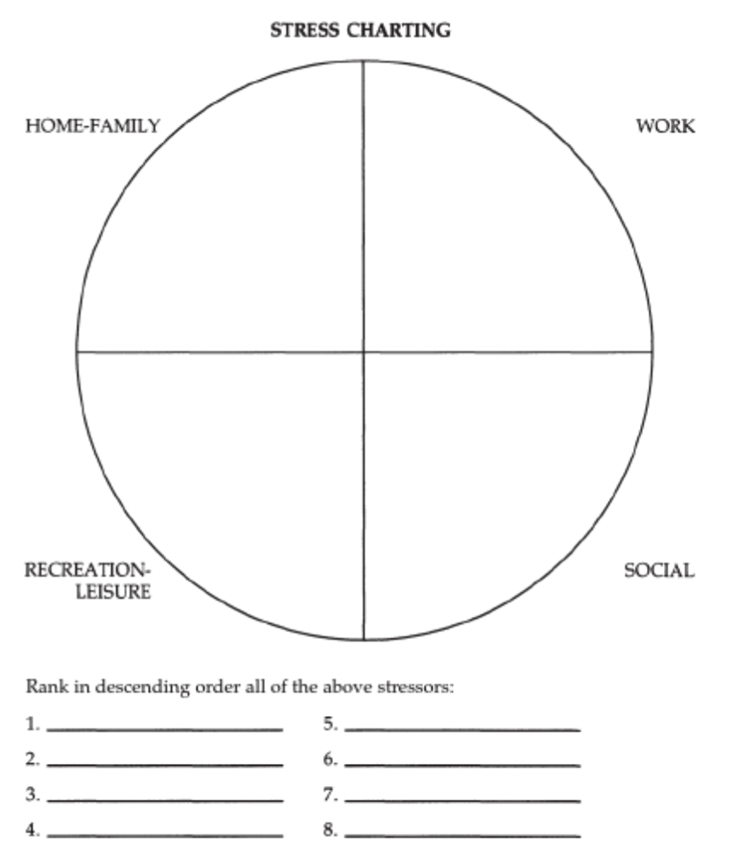
Identifying stressors
Look at the chart in TASK 4 of the PD1 Week 2 – Worksheet with your group. Brainstorm common stressors in life and categorise them in the chart. Then answer questions a-c together.

Slide 10
Stress management quiz
Follow the instructions in TASK 5 of the PD1 Week 2 – Worksheet and complete the Stress Management quiz on Career Zone.
Discuss in your groups:
What was your final score?
Do you think this reflects your ability to handle stress? Why/not?

Slide 11
Rethinking stress 1
Look at the page for Kelly McGonigal’s TED talk then answer the questions below:
What is the name of the video?
What website hosts the video?
Who is the speaker in the video?
In which year was the video published?
Why might it be useful to identify this information when you look at a source?

Slide 12
Rethinking stress 2
Read the True / False statements in TASK 6 of the PD1 Week 2 – Worksheet document. Then watch the video up to 7.21. In groups, decide whether the statements were True/False then modify the incorrect responses to make them true.
Discuss in your groups:
What did you learn from the video?
Do you agree with Kelly McGonigal’s conclusions? Why/not?
Do you think you will change your way of thinking about stress in the future? In what situations might this be useful?

Slide 13
Coping with Stress
Raber & Dyck (1993) also offers 4 conceptual methods for coping with stress. Those are:
Changing your internal attitudes / perceptions
Changing your interaction with the environment
Changing your physical ability to cope
Changing your environment
Discuss: What do you think is meant by each of these methods? Can you give examples for each?
Go to the PD1 Week 2 – Worksheet document and match the strategies to the relevant conceptual method in TASK 7.

Slide 14
Summary
Discuss in your groups:
If you had to summarize what you have learnt today about coping with stress, what would come to mind?
Which of the strategies for coping with stress presented today, do you think is useful?
Which of the strategies will you try and implement for yourself this trimester?

Slide 15

Summary

Slide 16
SUMMARY
After today’s class you should be able to:
Approach your career with a growth mindset
Rethink your understanding of stress and embrace it as a positive force in your life.
Use a variety of strategies to minimize stressors and optimise your environment for efficient studying.

Slide 17

Homework

Slide 18
HOMEWORK
Choose 1 more thing you wish to improve your mindset about in your life and come up with steps to improve on this (TASK 3 in the PD1 Week 2 – Worksheet document).
Listen to the video entitled “Accessing the Kortext Readings” in the tile for week 2 on the VLE. Then locate your copy of the Professional Development 1 Reader on Kortext. Find and read Chapter 6 (Why Mindset Matters) p.31-35 in The Successful Career Toolkit part of your reader.
Read p.41 of The Successful Career Toolkit book. Choose and highlight 3 strategies that you will attempt to use this trimester to manage your stress levels.

Slide 19

References
Barr, P. 2019, The Successful Career Toolkit, London: Kogan Page
Career Zone (n.d.) Stress Management [online] Available at: <https://www.abintegro.com/resources/careerassessments/> [accessed on 19th January 2022]
Dweck, C. S. (2017), The power of believing that you can improve [online] Available at: <https://www.ted.com/talks/carol_dweck_the_power_of_believing_that_you_can_improve?language=en> [accessed on 1st March 2022]
Growth Through the Middle Years (2019), Identify: Growth or Fixed mindset? [online] Available at: <https://www.youtube.com/watch?v=3vz6HU1LlOU> [accessed on 1st March 2022]
Mcgonigal, K. 2013. How to Make Stress Your Friend [online] Available at: <https://www.ted.com/talks/kelly_mcgonigal how to make_stress_your_friend> [Accessed on 19th January 2022]
Raber, MF, & Dyck, G 1993, Managing Stress for Mental Fitness, Course Technology Crisp, Menlo Park. Available from: ProQuest Ebook Central. [19 January 2022]

